Slide 1

CREDIT CARD MARKET ENTRY STRATEGY FOR INDONESIA
A comprehensive analysis of market opportunities, regulatory landscape, and strategic approaches for fintech companies targeting Indonesia's credit card market.
AI-Generated Presentation • Confidential

Slide 2
Executive Summary
1
2
3
4
5
Market size
Growth rate
Penetration rate
Digital transformation
Opportunity
Indonesia's credit card market to reach $87 billion by 2029
8.8% CAGR between 2025-2029
5% compared to regional benchmarks
Driving e-commerce expansion and digital payments
Dual-segment opportunity in affluent and mass market segments
2

Slide 3

Market size
1
Projected to grow to $87 billion by 2029
Indonesian Credit Card Market Overview
Growth drivers
2
Digital transformation and e-commerce expansion
Penetration rate
3
5% compared to regional benchmarks
Segmentation
4
Dual-segment opportunity in affluent and mass market segments
Regulatory environment
5
Comprehensive regulations from Bank Indonesia and Financial Services Authority
3

Slide 4
Key Market Statistics
MARKET SIZE
GROWTH RATE
PENETRATION RATE
DIGITAL PAYMENT ADOPTION
$87 billion
8.8%
5%
35%
Projected size by 2029
CAGR between 2025-2029
Compared to regional benchmarks
Of total transactions by 2025
4

Slide 5
Credit Card Penetration Rates in Southeast Asia
COUNTRY
PENETRATION RATE (%)
POPULATION (MILLIONS)
CARDS PER 1,000 ADULTS
Singapore
49.2
5.9
1,560
Malaysia
29.5
33.6
850
Thailand
22.6
70.1
320
Philippines
8.3
115.6
90
Indonesia
5.0
278.7
60
Vietnam
4.1
98.2
40
5

Slide 6
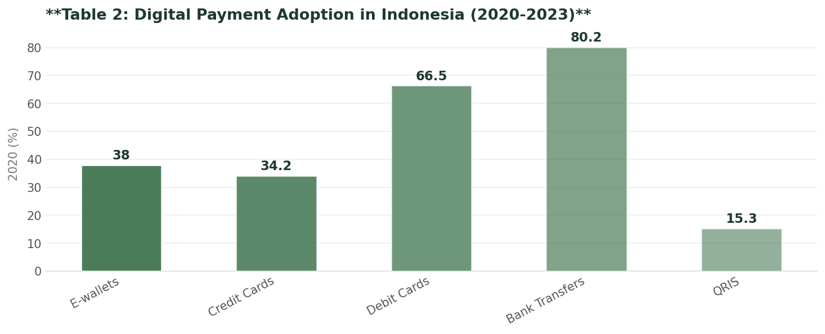
Digital Payment Adoption in Indonesia
Data visualization from document analysis
📊
6

Slide 7

Regulatory requirements
1
Comprehensive regulations from Bank Indonesia and Financial Services Authority
Regulatory Environment and Entry Barriers
Licensing requirements
2
Specific licensing requirements for fintech credit card issuers
Capital requirements
3
Initial capital requirements for market entry
Compliance
4
Ongoing compliance with regulatory requirements
Risk management
5
Effective risk management practices
7

Slide 8
Market Entry Strategy
01
02
03
04
05
Affluent segment
Mass market segment
Digital transformation
Regulatory compliance
Risk management
Targeted marketing and product offerings
Partnerships and strategic collaborations
Investment in digital infrastructure and technology
Ongoing compliance with regulatory requirements
Effective risk management practices
8

Slide 9
Financial Projections and Investment Requirements
MARKET SIZE
GROWTH RATE
INITIAL INVESTMENT
BREAK-EVEN POINT
$87 billion
8.8%
$10 million
3 years
Projected size by 2029
CAGR between 2025-2029
Required for market entry
Expected break-even point
9

Slide 10
Credit Card Market Size Projections in Indonesia
YEAR
TRANSACTION VALUE ($ BILLION)
ANNUAL GROWTH (%)
CARDS IN CIRCULATION (MILLIONS)
2023
21.6
5.2
17.8
2024
23.5
8.8
19.2
2025
26.3
11.9
21.5
2026
30.2
14.8
24.3
2027
35.8
18.5
27.6
2028
43.6
21.8
31.5
2029
87.0
99.5
36.2
10

Slide 11
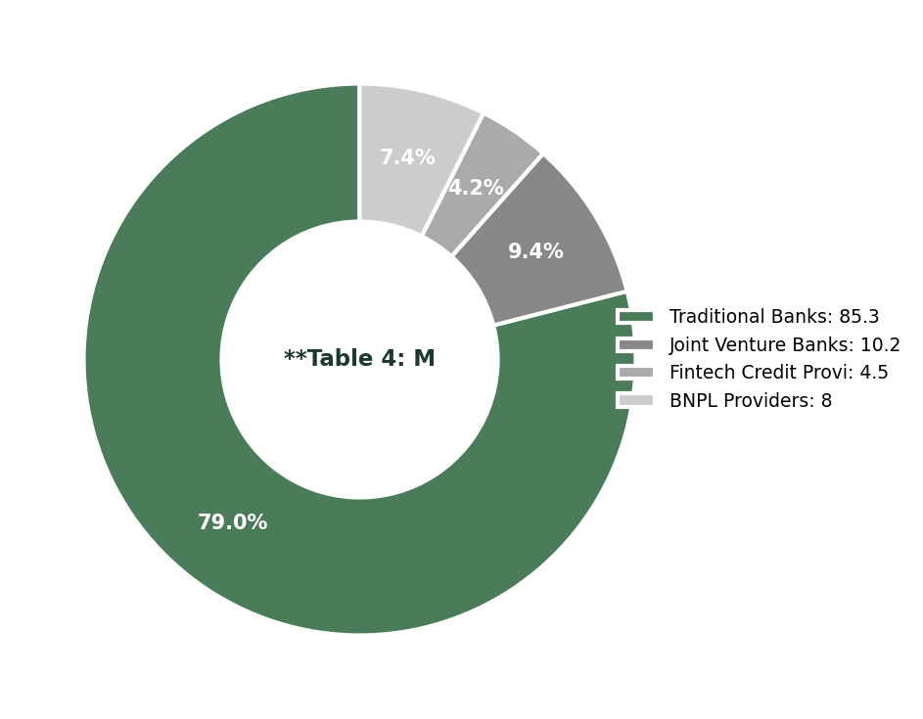
Market Share Distribution in Indonesian Credit Card Market
Data visualization from document analysis
📊
11

Slide 12

Conclusion and Strategic Recommendations
→
Market opportunity: Dual-segment opportunity in affluent and mass market segments
→
Regulatory compliance: Ongoing compliance with regulatory requirements
→
Digital transformation: Investment in digital infrastructure and technology
→
Risk management: Effective risk management practices
→
Market entry strategy: Targeted marketing and product offerings
12

Slide 13
Indonesia's Credit Card Market Will Reach $87 Billion by 2029
→
Market size: $87 billion by 2029
→
Growth rate: 8.8%
→
Penetration rate: 5%
→
Digital payment adoption: 35%
13

